Slide 1
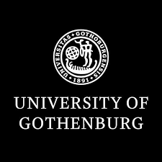

Språkbanken fOr Beginners
A research infrastructure for language data and a language technology research unit
2025

Slide 2
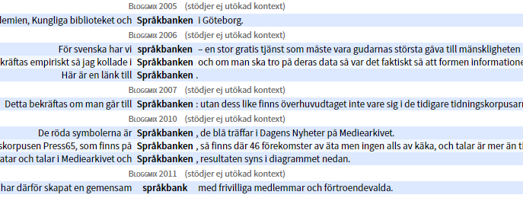
contents
What is Språkbanken Text?
Our data
Our platforms
Example applications
Other things we do
What we can help you with

Slide 3
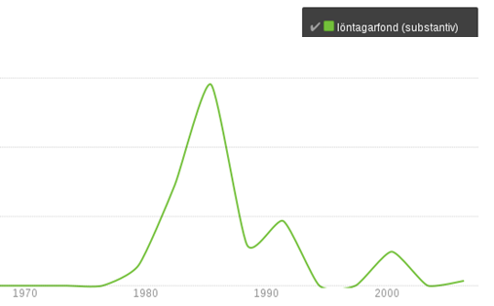
What is Språkbanken Text?
A bank creates profit
Språkbanken creates knowledge

Slide 4
Who needs Språkbanken Text?
Any researcher in the field of human communication:
computer scientists
philologists
gender scientists
historians
health researchers
cultural scientists
linguists
literary scholars
media scientists
education researchers
psychologists
social anthropologists
language technologists
political scientists
and more!

Slide 5




There are more than one språkbank
Språkbanken is a research infrastructure financed jointly by the Swedish Research Council and 10 universities and government organisations.
It consists of three divisions: Språkbanken Sam, Språkbanken Tal and Språkbanken Text.
This presentation is about Språkbanken Text, which works with written language data.

Slide 6
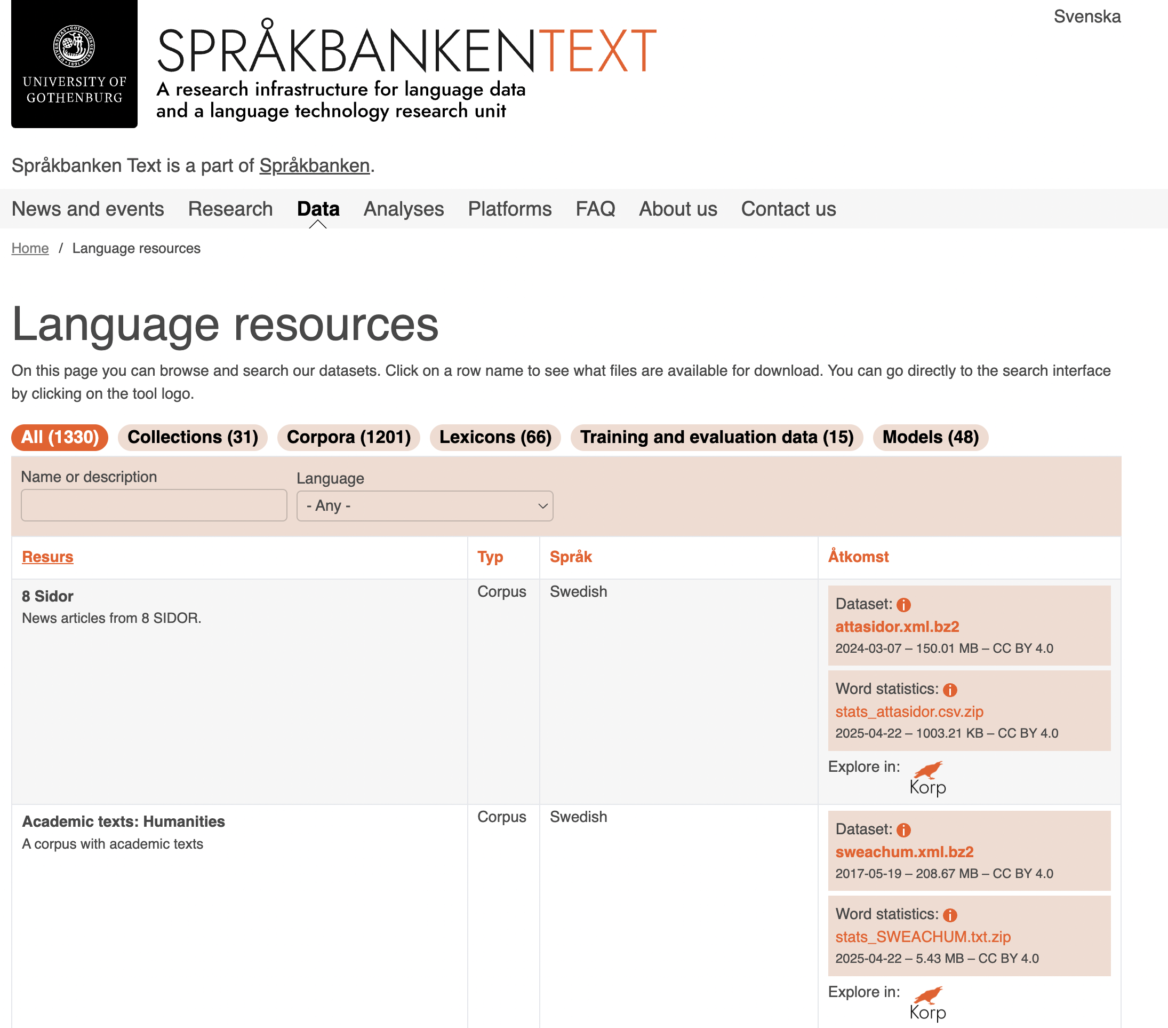
Our data
More than 1000 corpora
More than 50 lexicons
You can seach for and download them on our webpage: spraakbanken.gu.se/en/resources

Slide 7
What is a corpus?
Annotation gives information:
Morphological: Boken is a noun, singular definite form, the same word as bok, böcker and böckerna
Syntactic: Jag läser en bok: bok är the object
Semantic: Vilken sense of bok – "book" or "beech"?
Metadata: In what context is the word used? Who wrote the text? When?
A large searchable collection of texts.
To improve searchability, corpora are often annotated, that is, linguistic information has been added.
The annotation is often done by a computer, and may contain errors.

Slide 8
Some of Språkbanken's Corpora
fiction
newspapers
magazines
social media
blogs
webforums
Twitter
government documents
Wikipedia
Finland Swedish
historical texts
Old Swedish
modern Swedish
parallel texts
the same texts in 25+ languages
the Gigaword corpus
a large, balanced corpus of different genres of modern Swedish from 1950 forward

Slide 9
Some of Språkbanken's lexicons
SALDO: a semantisc and morphological lexicon
Hellquist's Swedish etymological dictionary
Bliss symbol lexicon
Schlyter's and Söderwall's dictionaries of medieval Swedish
attitude lexicon
lexicon of borrowed words
Swesaurus (a Swedish word net, a Swedish conceptual lexicon)
Our lexicons are made for automatic text analysis.

Slide 10
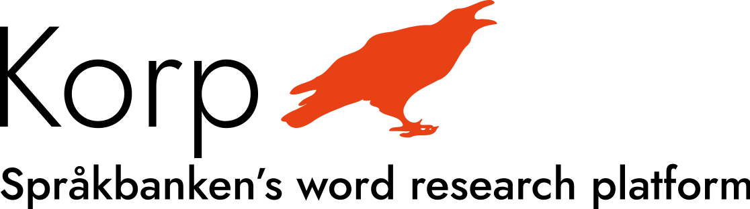
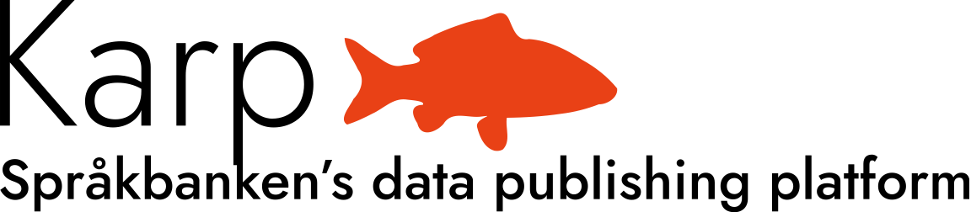
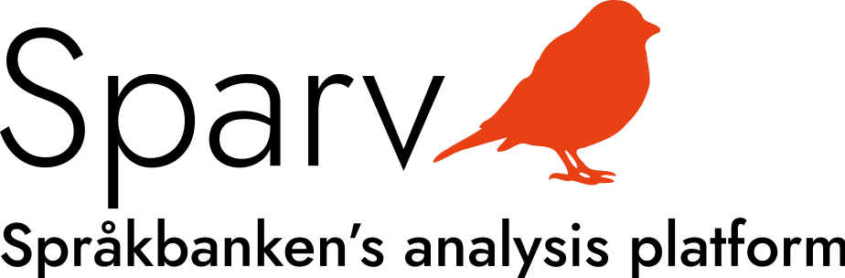
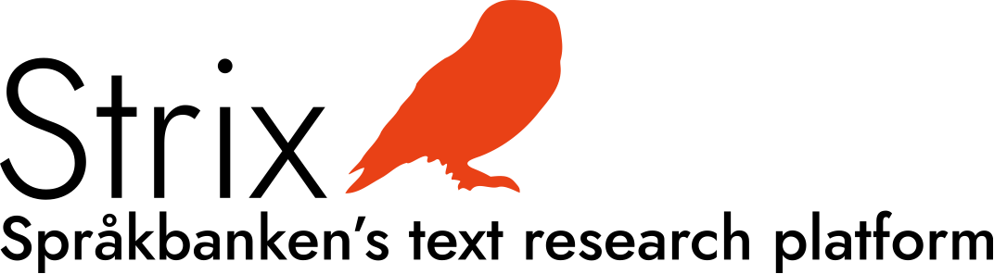
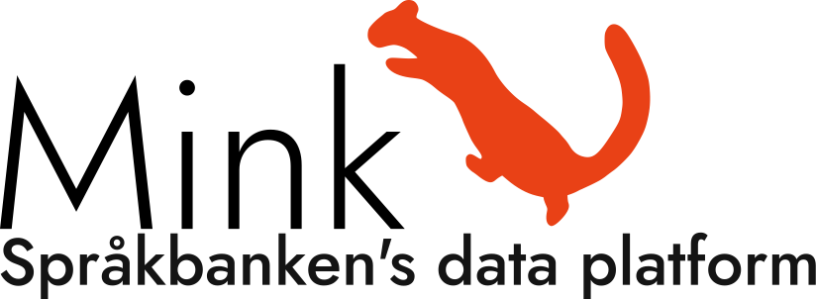
Språkbanken's most important platforms
Korp: a search engine which gives you access to 30 000 million words in Språkbanken's corpora.
Karp: a platform for working with our lexicons.
Sparv: an annotation platform for adding morphological, syntactic and semantic information to text.
Strix: a search engine which is document centered and can focus more on the semantic content of the document.
Mink: a platform where you can apply our language technology methods to your own texts.

Slide 11
What is Korp?
a search engine
made for investigating linguistic phenomena

Slide 12
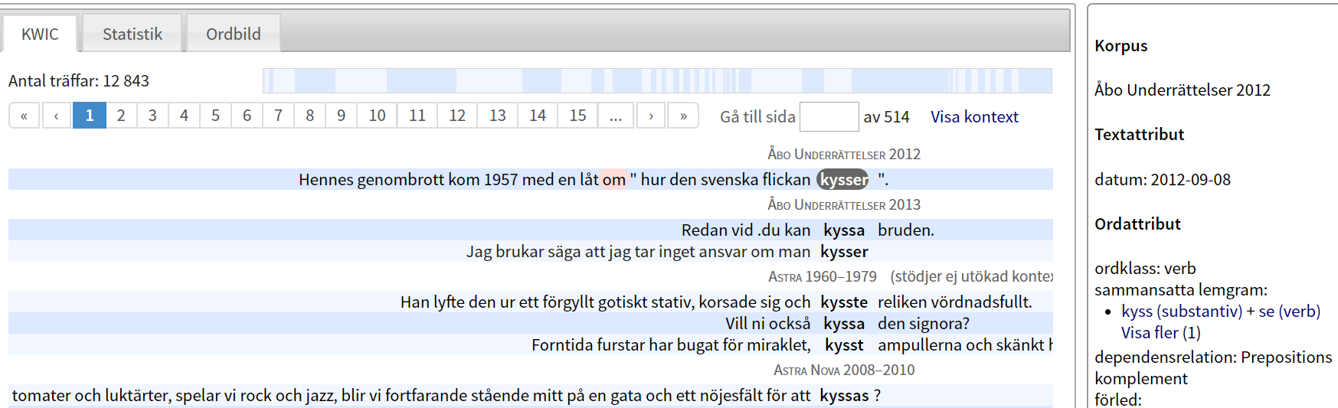
Word search
Gives information about the frequency of a word and shows all its occurrences in context. The word kyssa "kiss":
Info about the corpus
Frequency
Name of the corpus
Info about the word
Examples
Sometimes the automatic analysis makes mistakes.

Slide 13
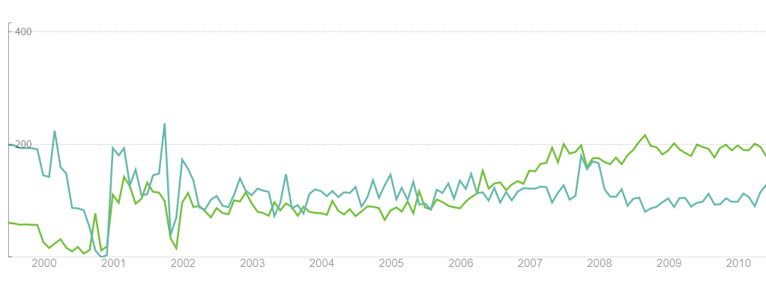
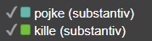
Trend diagrams
Language change:

Slide 14
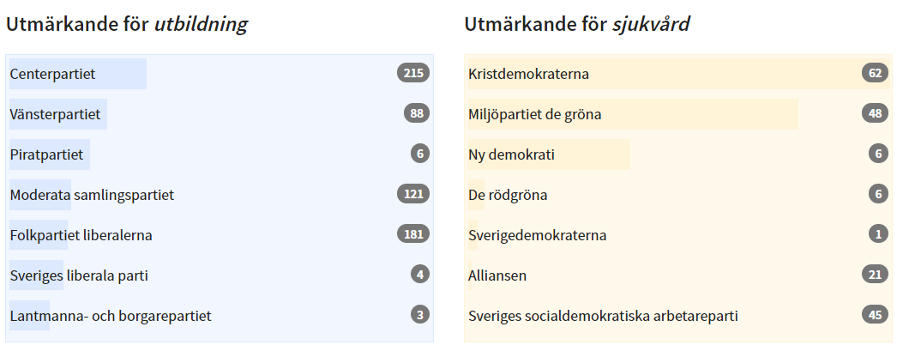
Comparisons based on
probability
Which political parties focus more on education, and which focus more on healthcare?

Slide 15
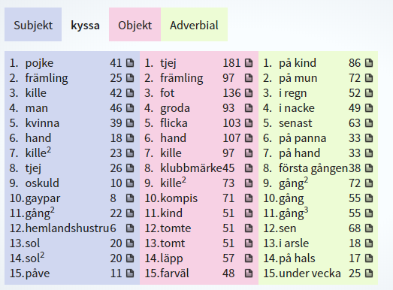
Word pictures
Who kisses whom/what, and in what way?

Slide 16
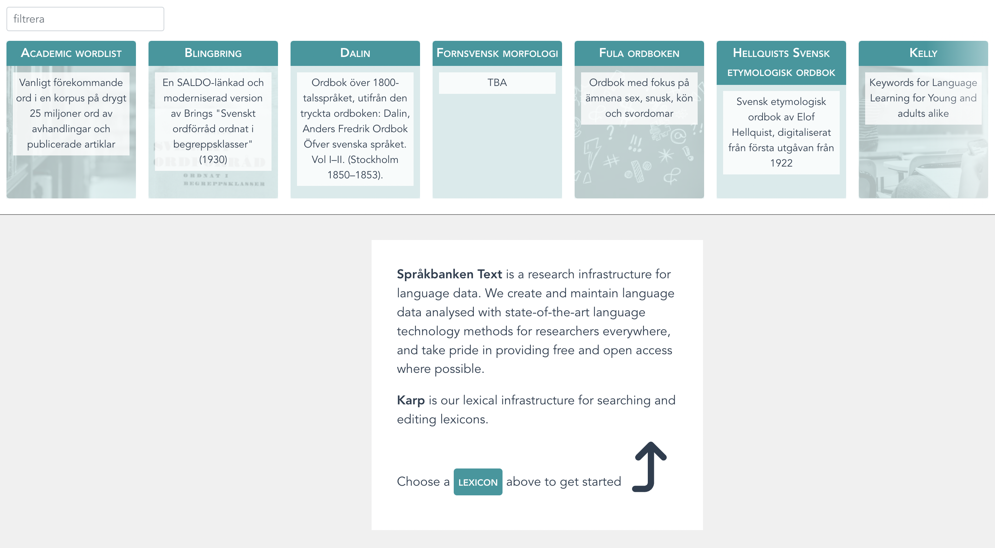
What is Karp?
A tool for working with Språkbanken's lexicons.

Slide 17
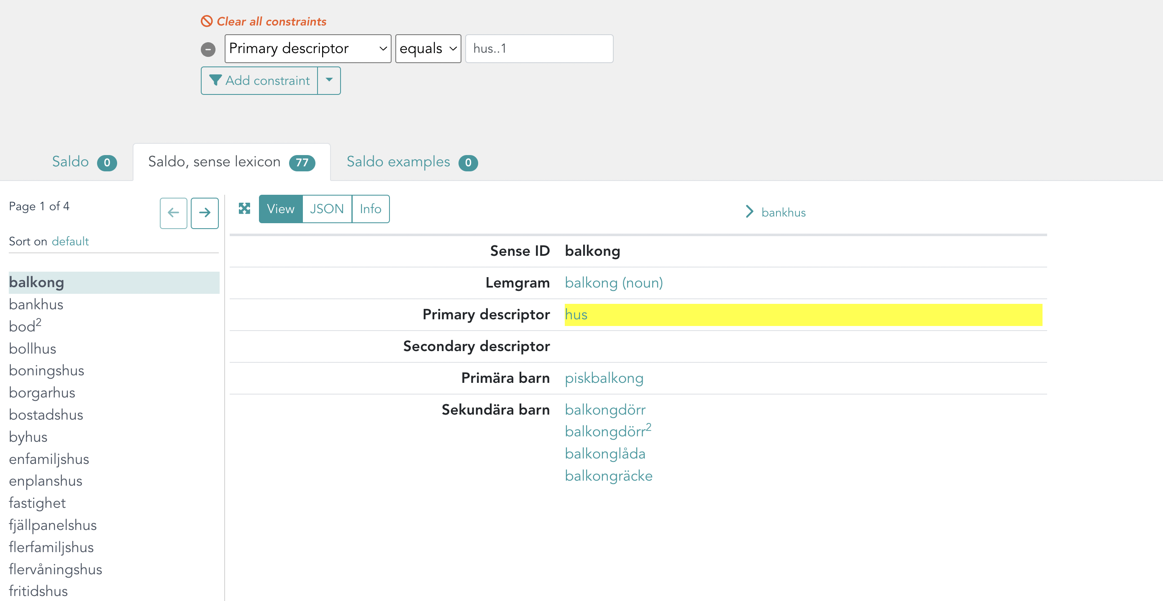
SALDO
What is the semantic neigbourhood for hus "house"?

Slide 18
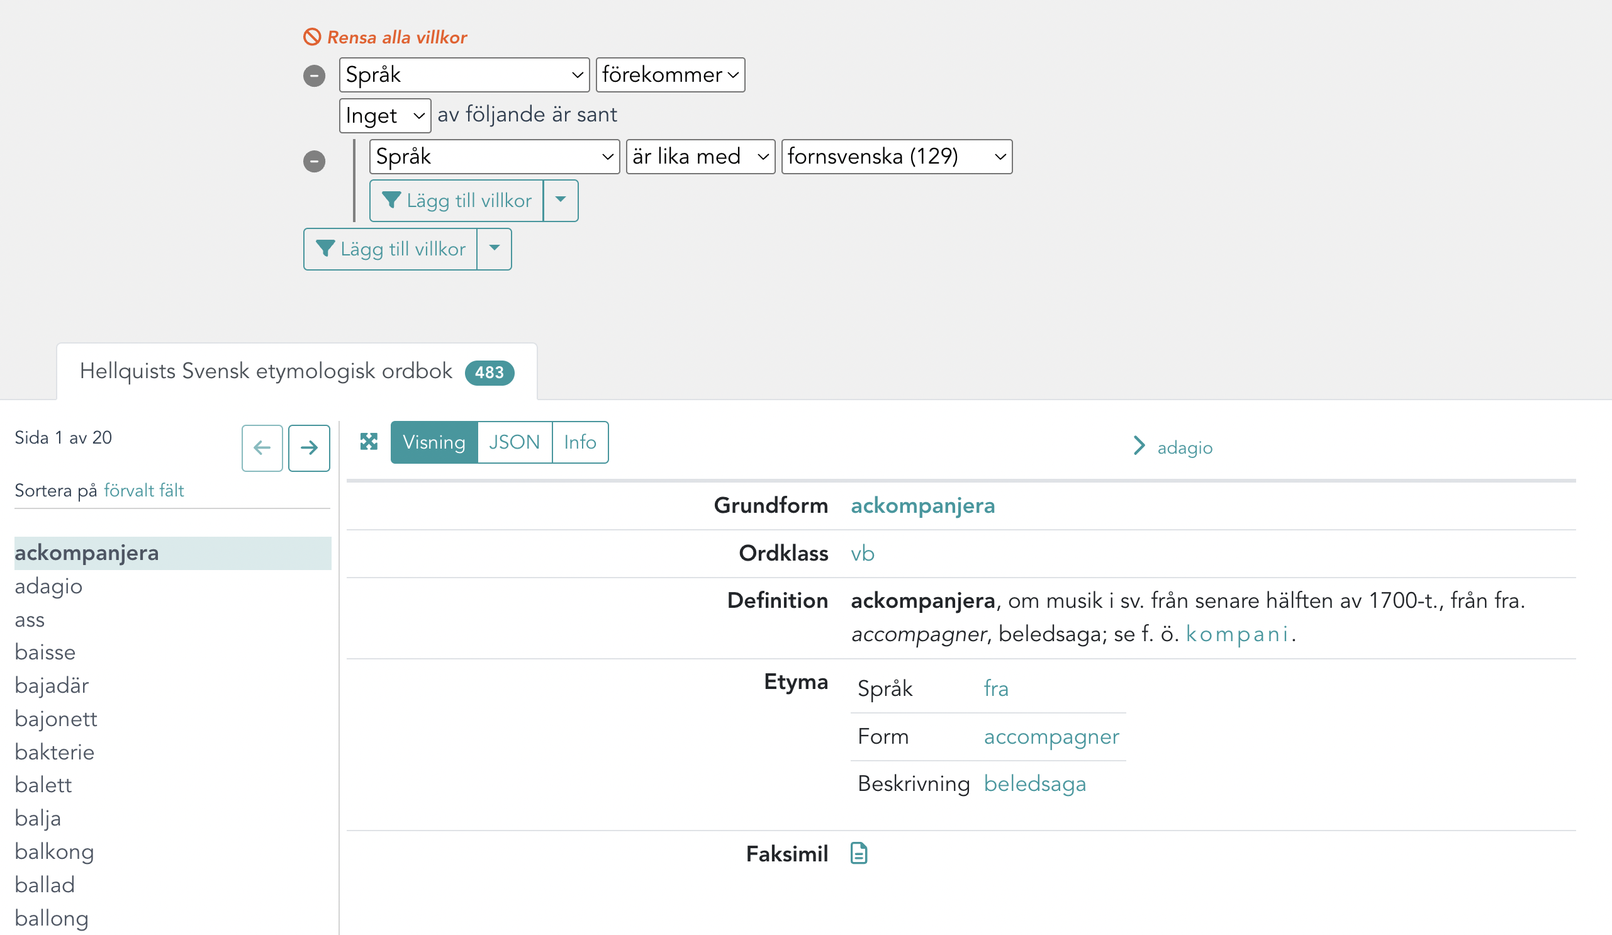
Etymological dictionary
From which languages does Swedish have the most loan words?
The query: “find all entries where a source language is given, and that language is not Old Swedish”

Slide 19
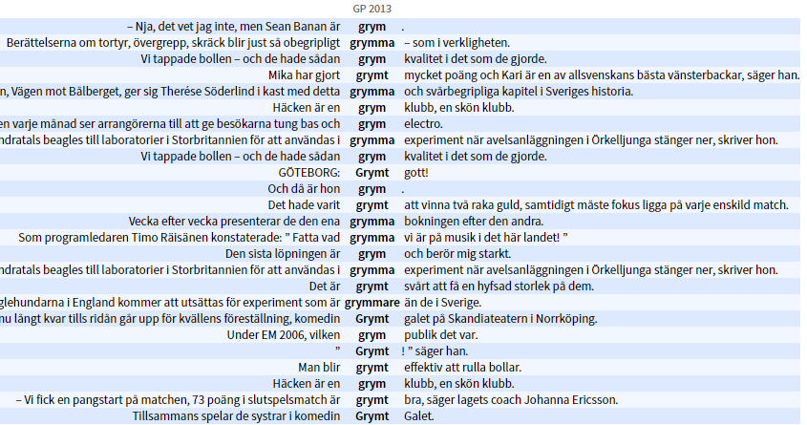
More about Korp
Let's search for the word grym "cruel, wicked":
Different senses!

Slide 20
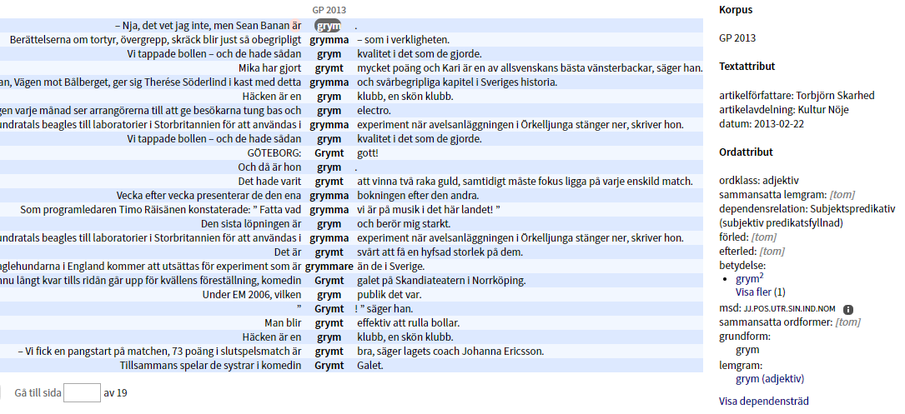
Automatic text analys
Senses in Korp:

Slide 21
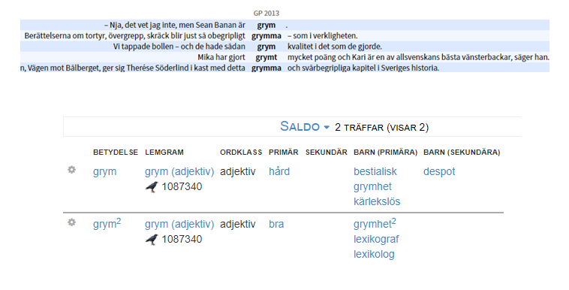
Automatic text analys
The senses in Korp come from the SALDO lexicon:

Slide 22
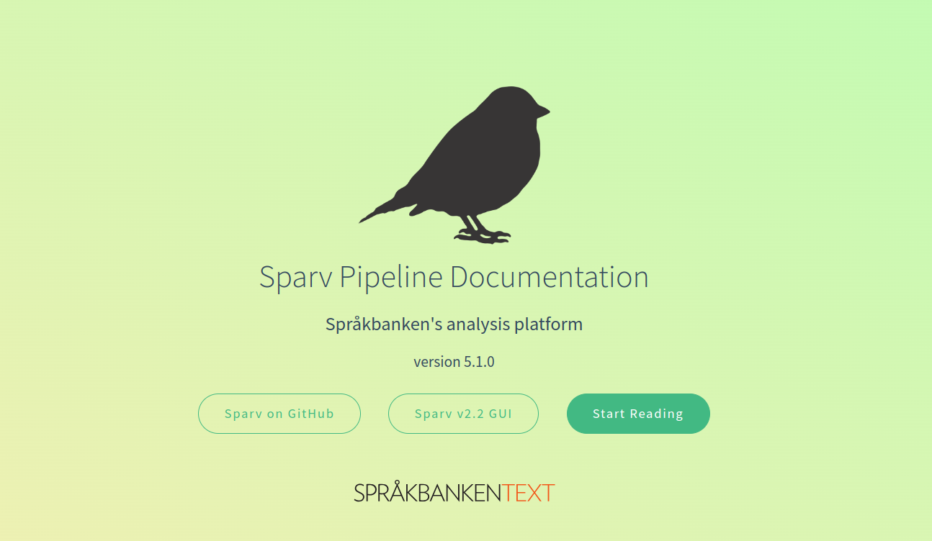
What is Sparv?
Sparv can annotate your texts, and add:
lexical analysis
syntactic analysis
semantic analysis
sentiment analysis
readability analysis
and more!

Slide 23
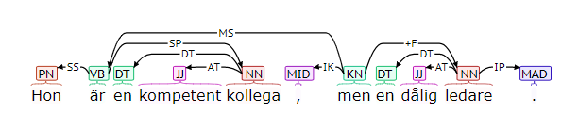
Syntaktic analysis
Hon är en kompetent kollega, men en dålig ledare.
"She is a competent colleague, but a poor leader."

Slide 24
Semantisk analys
Hon är en kompetent kollega, men en dålig ledare.
The word ledare has at least three senses:
Sense | Probability in this sentence, according to Sparv
leader | 0,65
electric conductor | 0,21
editorial | 0,14

Slide 25
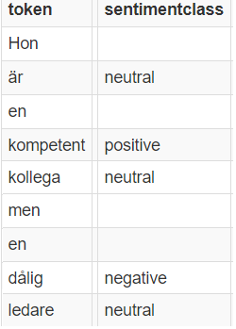
SENTIMENT analysis
Hon är en kompetent kollega, men en dålig ledare.

Slide 26
What is Strix?
A search engine which:
is focused on entire documents (unlike Korp, which focuses on words)
analyses the semantic contents of the document

Slide 27
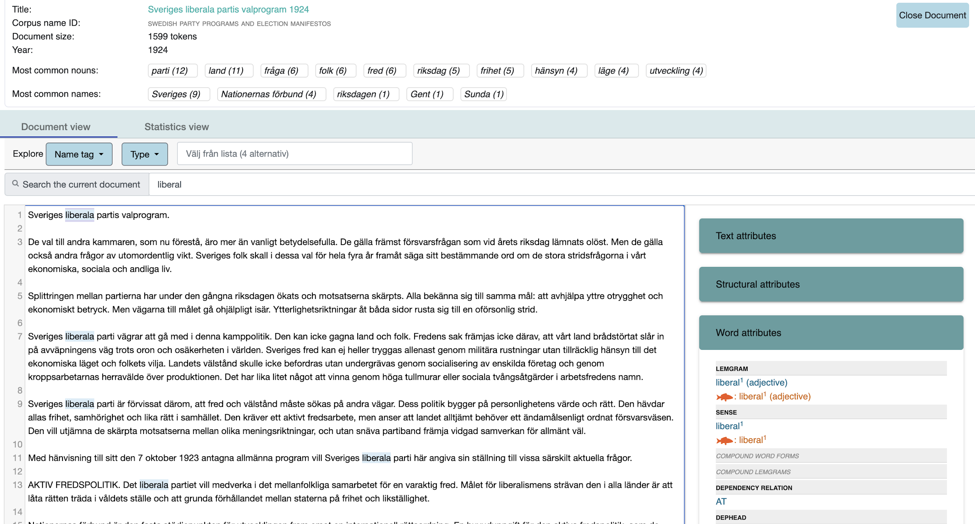
What can Strix do?
text analysis
find keywords
find names
sentiment analysis
topic classification
show entire annotated documents
work with collections of documents
show metadata

Slide 28




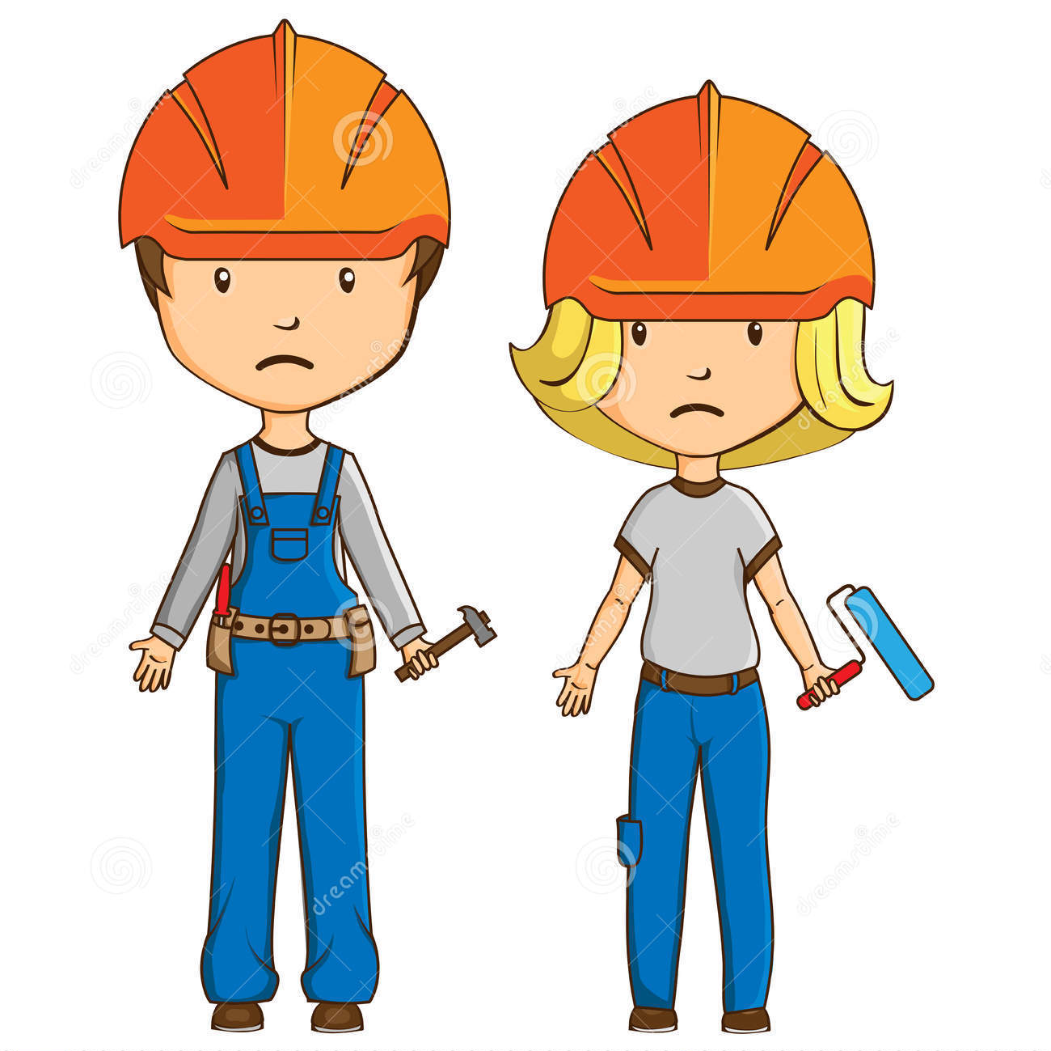



What is Mink?
Adding new corpora involves Språkbanken Text.

Slide 29




What is Mink?
With Mink, you can add and analyse your own texts!

Slide 30
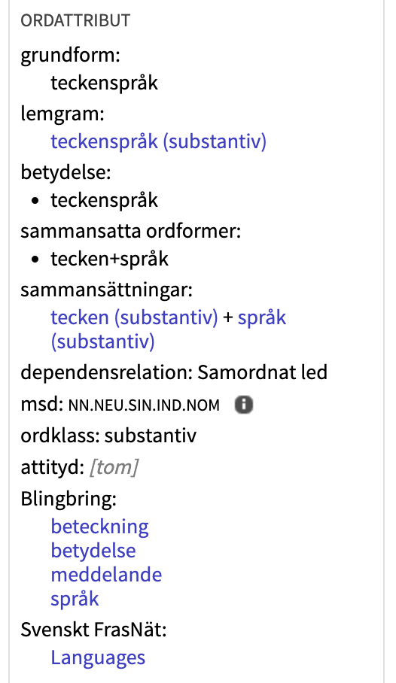
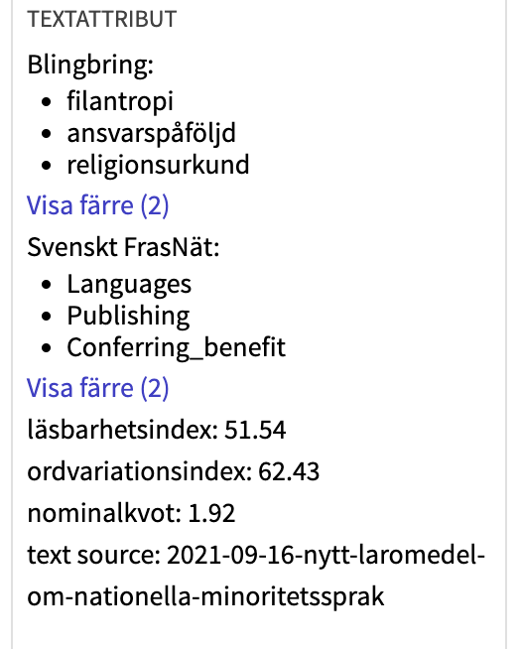
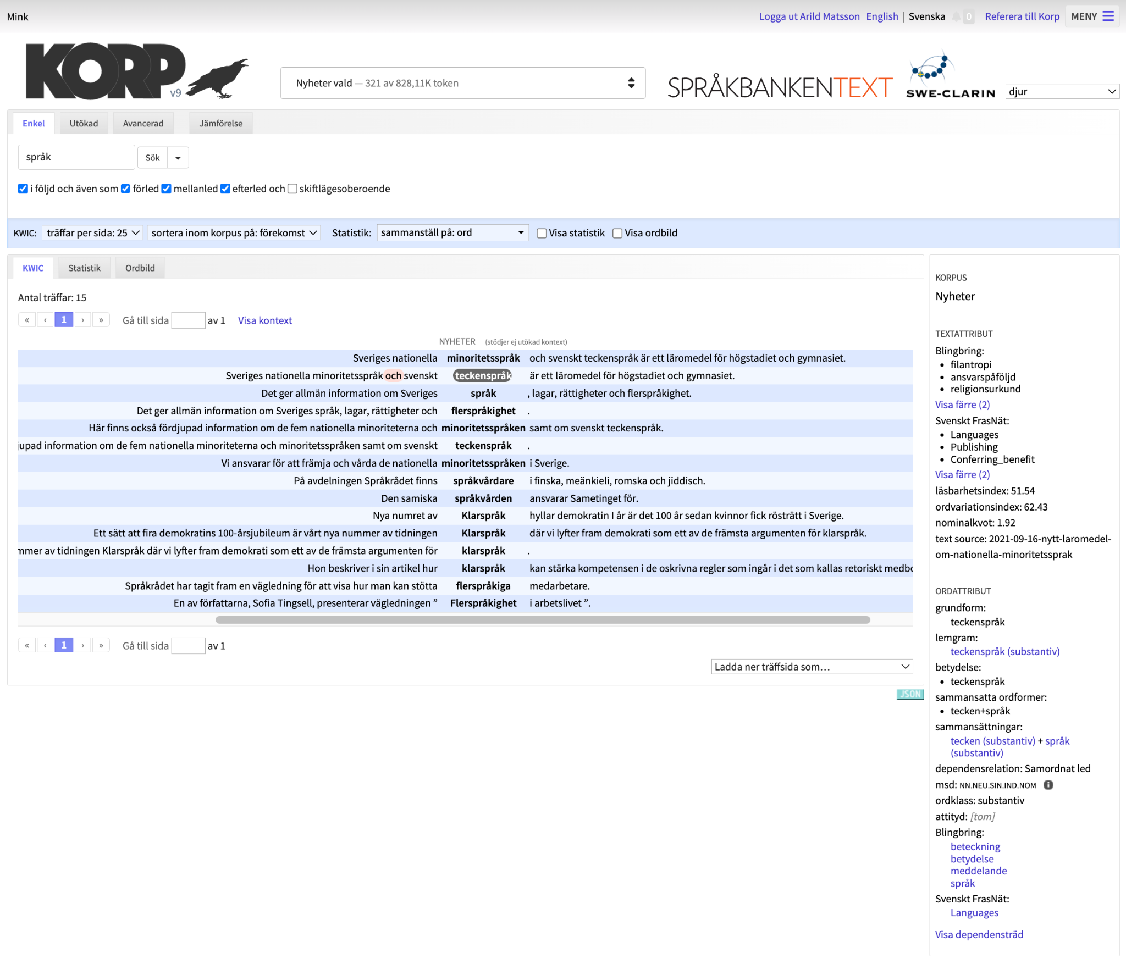
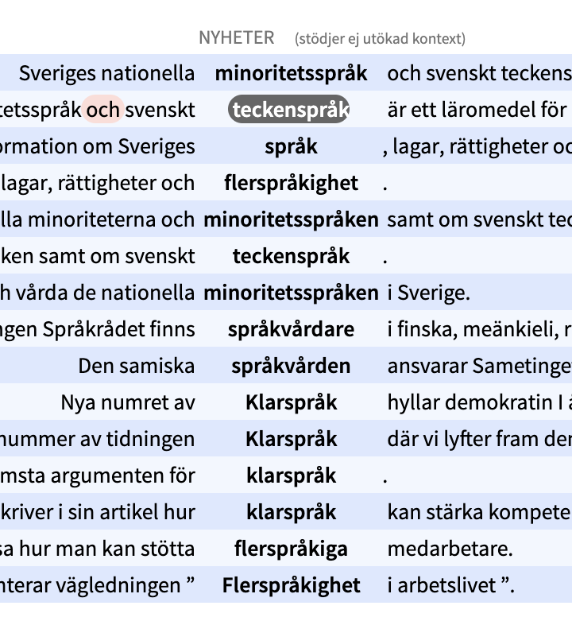
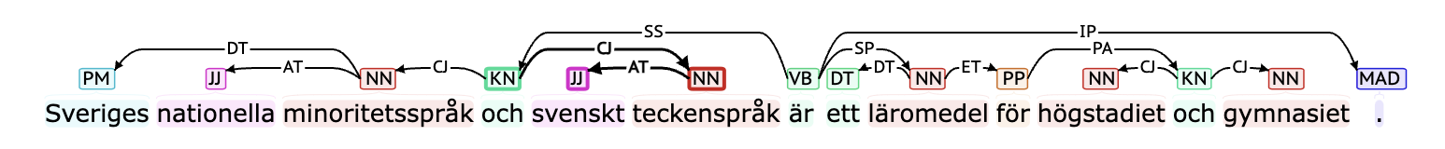
What is Mink?
Then Sparv runs in the background and annotates your text.

Slide 31
Technical use of our platforms
Most of our tools are open source.
Korp and Sparv can be used through an API.
Korp can be adapted to other corpora and other languages, and is used in Italy, Estonia, Finland, Iceland, Denmark och Norway.

Slide 32
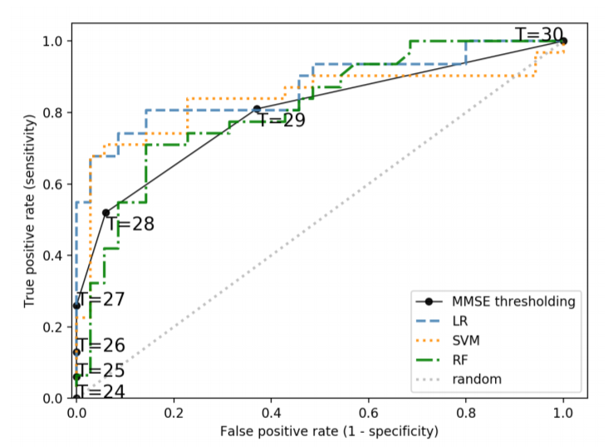
Examples of applications
Language technology supports medical diagnostics:
A common test used to diagnose mild cognitive impairment (MCI) has an accuracy ("AUC score") of 68%.
If we supplement the test with automatic analysis of the patient's language, the accuracy is improved to 87%.
Fraser, K., Lundholm Fors, K., Eckerström, M., Themistocleous, C., & Kokkinakis, D. (2018). Improving the sensitivity and specificity of MCI screening with linguistic information.

Slide 33
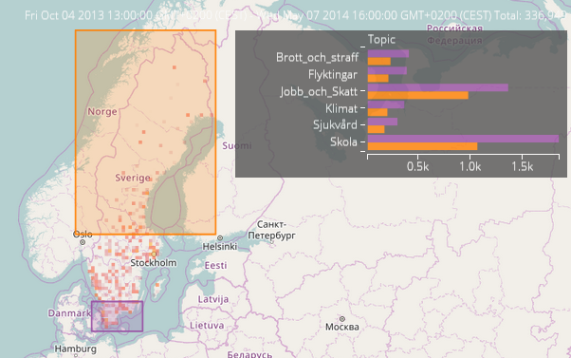
Examples of applications
What are Swedes discussing on X (Twitter) right now?
Orange versus purple: How much is the topic discussed in northern versus southern Sverige?
We see no big differences in the distribution.
Borin, L., & Kosiński, T. 2016. Towards interactive visualization of public discourse in time and space

Slide 34
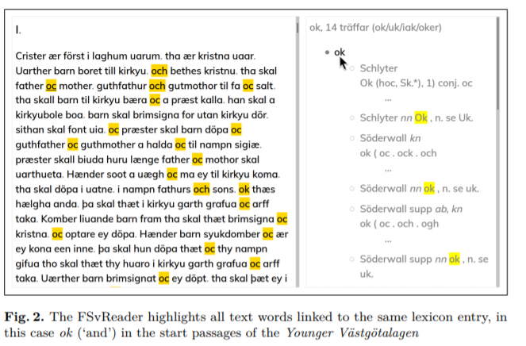
Examples of applications
Simplifying the reading of historic texts.
Adesam, Y., Ahlberg, M., & Bouma, G. 2018. FSvReader – Exploring Old Swedish cultural heritage texts.

Slide 35
Examples of applications
More examples of research where language technology plays a part:
How can we see the growth of consumerism in older Swedish novels (1830–1860)?
Grammar books contain valuable information about thousands of languages. Can we extract that information automatically?
How can we use "big data" and language technology to analyse changes in language and society over time?
spraakbanken.gu.se/en/research

Slide 36
Other things we do
Teach language technology
Supervise doctoral students
Inform about our resources, our research, and language in general
Answer questions from researchers and the public
Arrange workshops
Arrange user days
Blog

Slide 37
What can we help you with
Other things we can do:
Arrange a workshop to help you or your students get started with Språkbanken Text and language tecnology.
Help you use Språkbanken Text for your research question.
Cooperate to find new research questions.

Slide 38
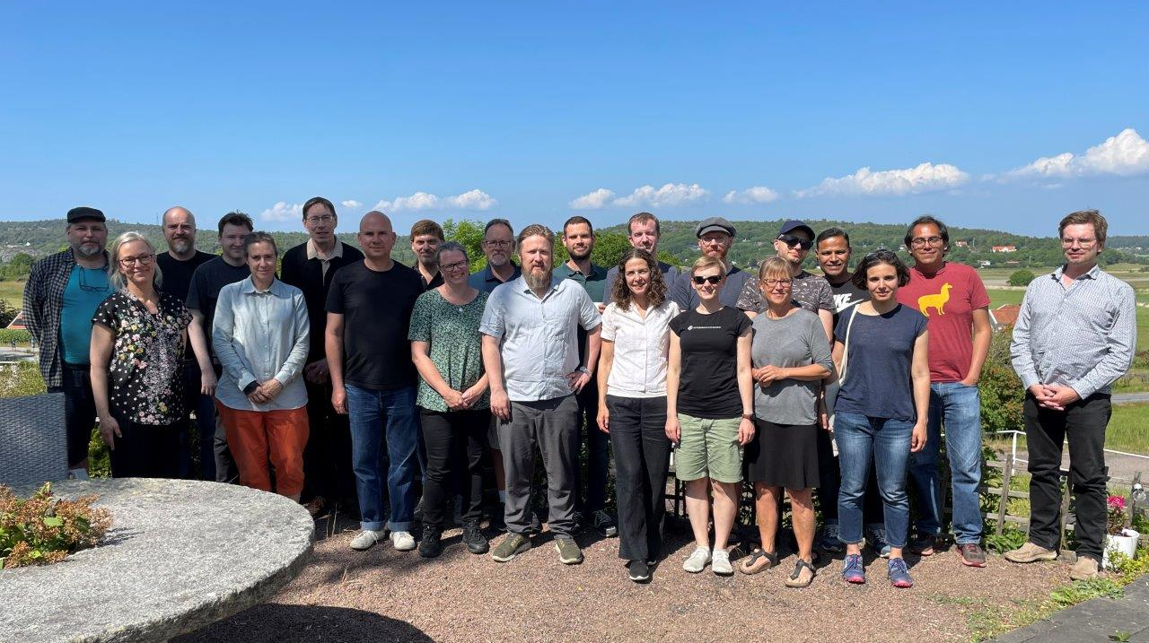
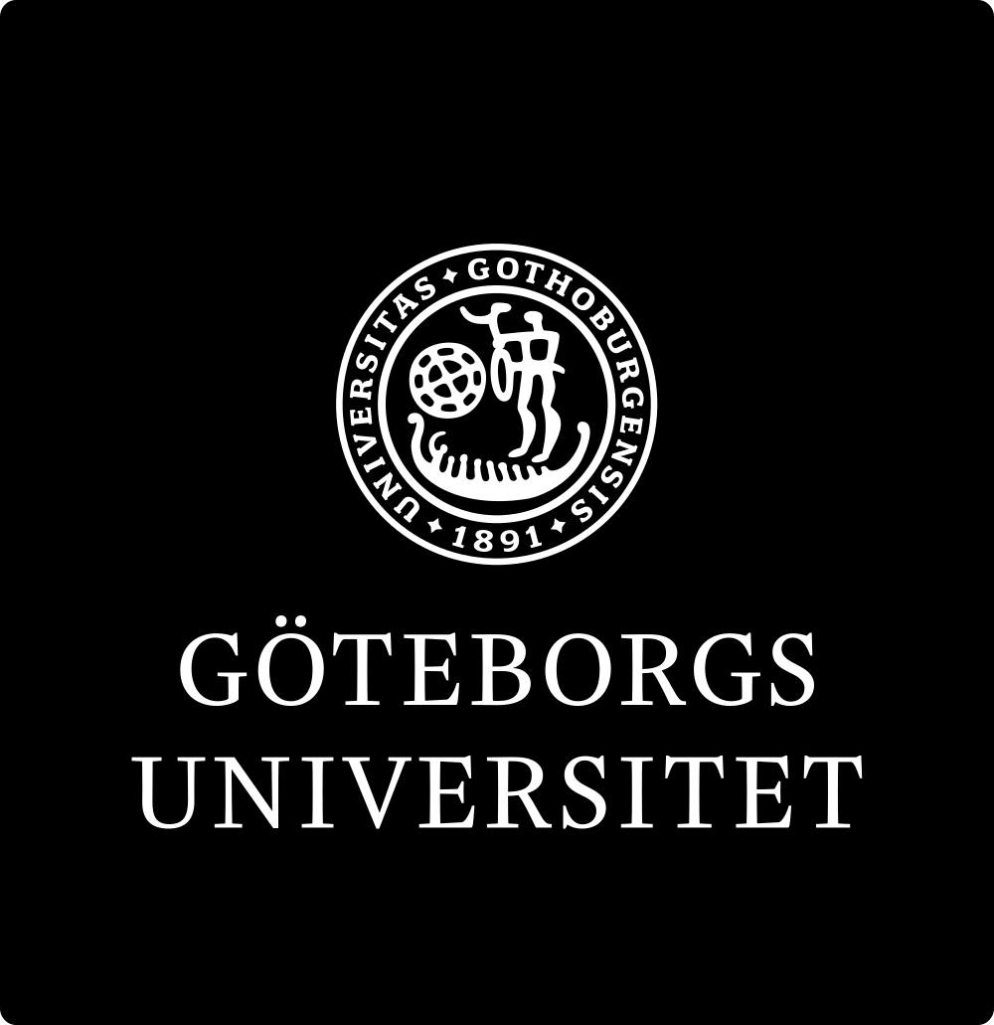
A research infrastructure for language data and a language technology research unit
spraakbanken.gu.se

